Slide 1
Making the Most of Social Media
North Wind CCL Regional Conference 2017

Slide 2
Making the Most of Social Media
Social Media Stats
Do’s and Don’ts
Connecting to Congress
Social Media Goals
Facebook

Slide 3
Social Media Stats
How many out of every ten Americans is using social media?
What percentage of adults are getting their news from social media?
Which social media sites are most popular?
What percentage are visiting these sites at least once a day?
Notes:
7
67%
In order: Facebook, Instagram, Twitter
Facebook 76%, Instagram 51%, Twitter, 42%

Slide 4
Do’s and Don’ts
Do
Don’t
Be nice
Mention your location
Identify with your group
Comment on MOC’s posts
Respond quickly
Post appreciations
Promote an LTE or Op-Ed
Support or oppose specific issues
Educate with information
Post too often to your MOC
Be nasty or crazy
Don’t repeat yourself
Leave out constituent information
Leave out group affiliation

Slide 5
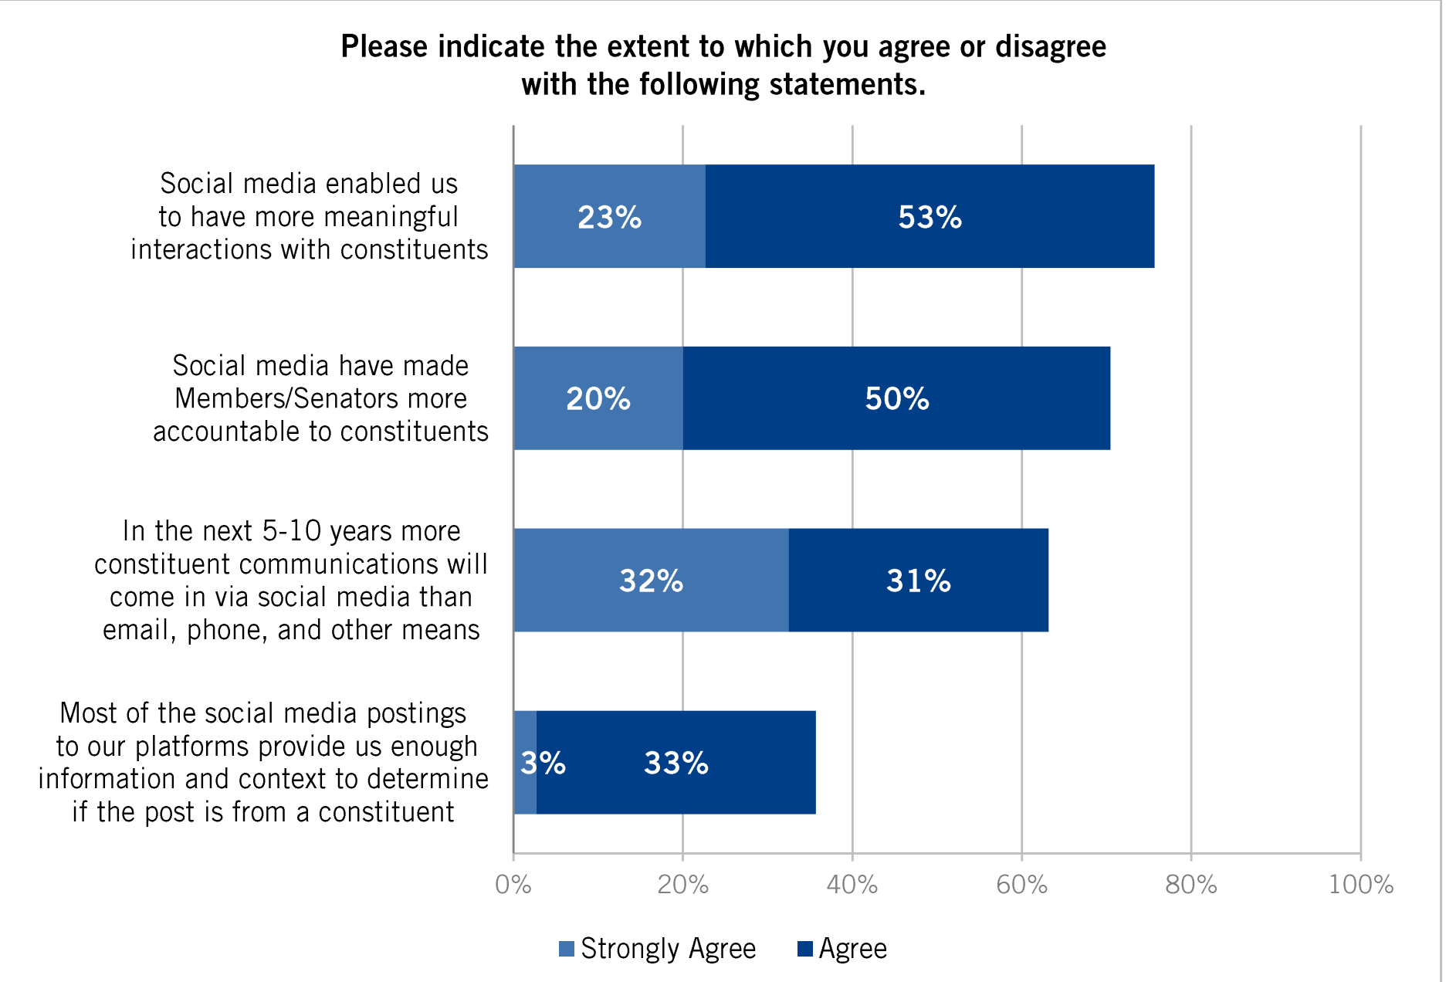
Connecting to Congress

Slide 6
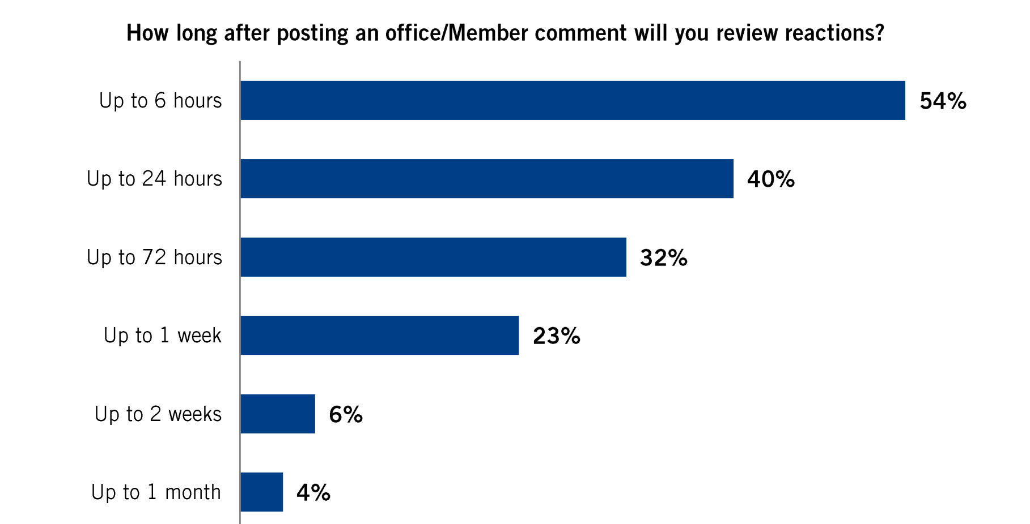
Connecting to Congress

Slide 7
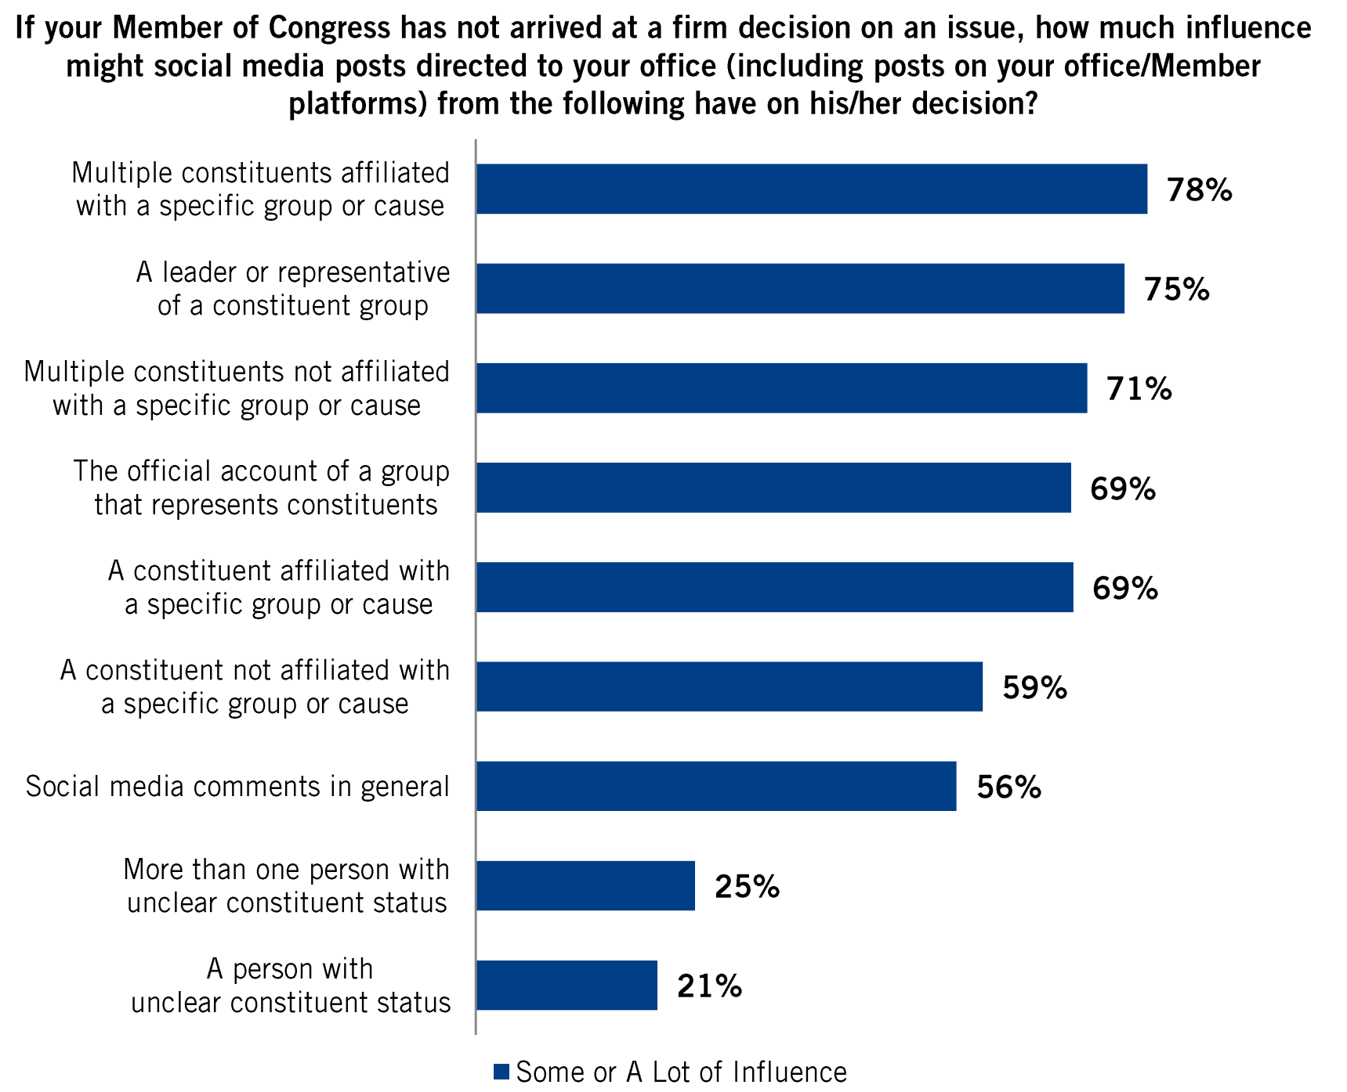
Connecting to Congress

Slide 8
Social Media Goals
Recruit new members
Inform and engage the public
Motivate action online and in real life
Connect with other organizations and build alliances
Attract attention of MOC and their staff

Slide 9
Facebook
Profiles
Pages www.facebook.com/pages/create
Groups
Notes:
Personal
Public
Private group

Slide 10
Facebook (How to Get ‘Likes’)
Invite your Facebook friends
Invite everyone in your chapter by email and at meetings
Ask them to invite their Facebook friends to like
Add page link to your chapter and/or personal email signature
Like other pages

Slide 11
Facebook Posts
70% value content
Videos, videos, videos! (and images)
3 seconds
Native uploads
80 – 100 characters get higher engagement
20% shared content
10% promotional content
Events
Notes:
Value content: news articles, LTE publications, photographs, meme, VIDEOS!, Facebook live
You have 3 seconds to get somebody engaged
Shared content: sharing other people’s posts
Promotional: events, donations, intro call invites
Events:

Slide 12
Facebook Posts
Specific requests
Express thanks
Promote and praise volunteers
Use specific calls to action
Notes:
- Calls to action: ask people to share posts or article, click the news article, love this article

Slide 13
Facebook Events
Before
Chapter meetings and functions
Share events
Ask for shares
Invite others
Share events in other groups and pages
During
Take and post pictures
Ask people to “check in” at event
After
Thank those who attended
Share pictures and ask attendees to share theirs too

Slide 14
QUESTIONS?

