Slide 1
Endorsements
Program Overview

Slide 2
Endorser Program CCU Series
101: Program Overview (why and what)
201: Endorser Database (how)
301: Getting Endorsements (how)
Engaging Elected State Leaders (Joseph Chiarell)
Engaging a Specific Industry (Bill Barron)
Coordinating Actions (Craig Preston)
Endorser Program Support Tools (Peter)
Notes:
Explain why there’s no “inspiring story” to start – we are assuming the audience is already interested/active with the Endorser Program and are looking for support

Slide 3
101
201
301

Slide 4
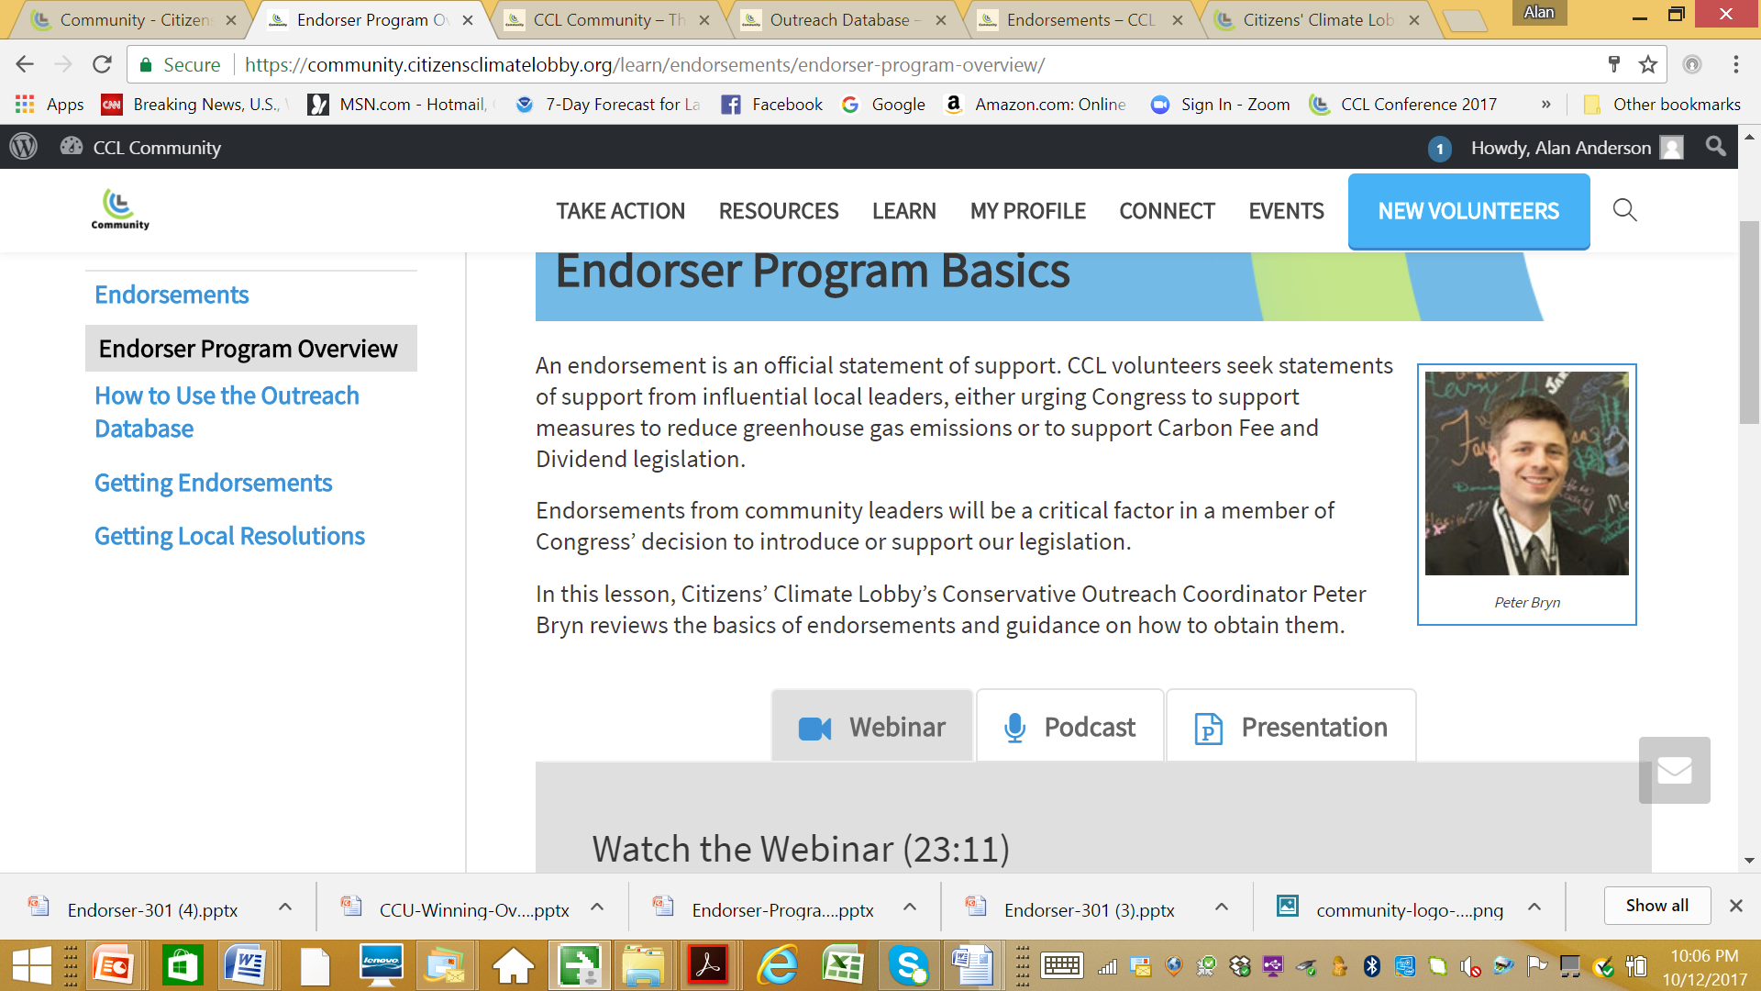
101
Endorser Program 101:
Program Overview

Slide 5
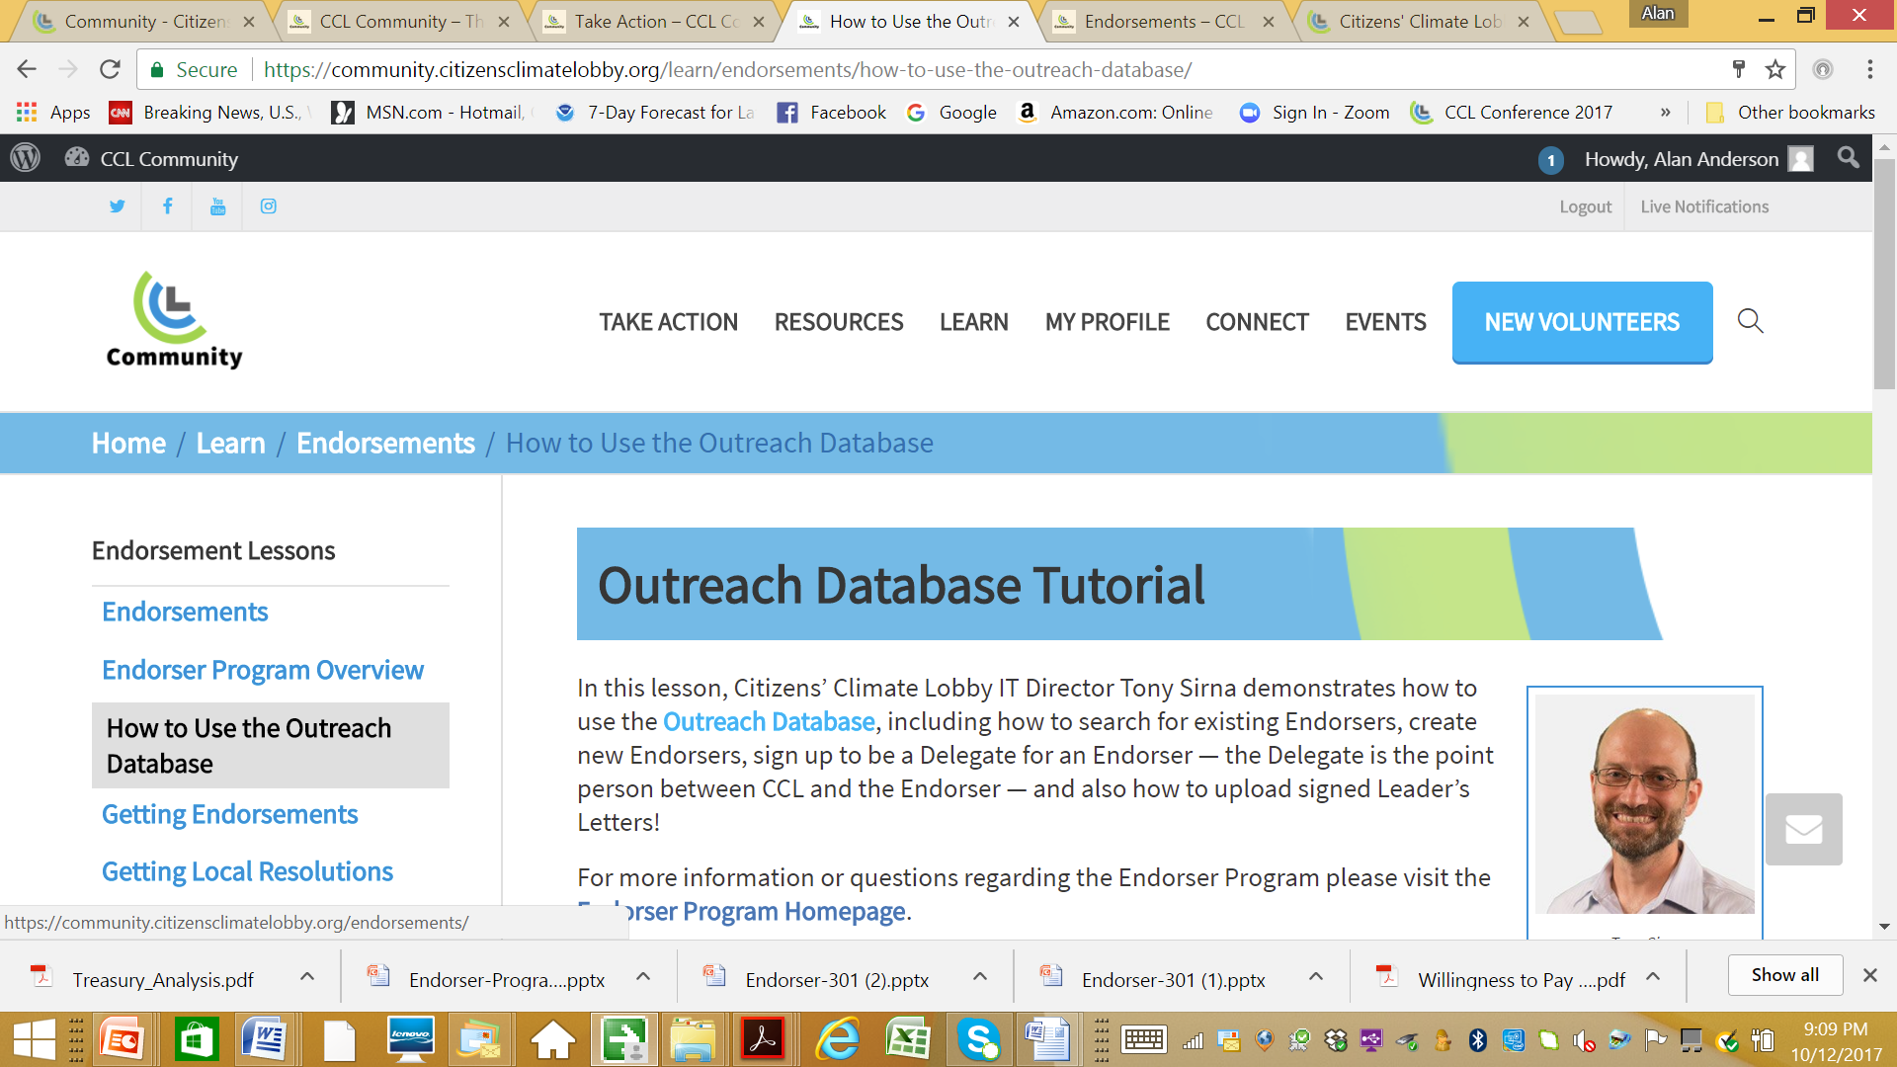
201

Slide 6
Home Take Action
Database

Slide 7
Outreach Database

Slide 9
301

Slide 10
CCL’s Levers of Influence
LOBBY
Direct Lobbying
Letters to Members of Congress
MEDIA
Opinion Editorials (OpEds) Letters to the Editor (LTEs)
Congress Sees Political Will
Congress Acts
OUTREACH
Grassroots: Individual constituents
Grasstops: Community leaders
Notes:
Peter

Slide 11
Potential Endorsement Opportunities
Veterans groups
Faith leaders
Farm bureaus
Professors
Service organizations
Chamber of Commerce
Party leaders
Leaders of causes on which MOC already focuses
Business owners
Campaign donors
University presidents
Local politicians
Other influencers to MOC
Notes:
Peter

Slide 12
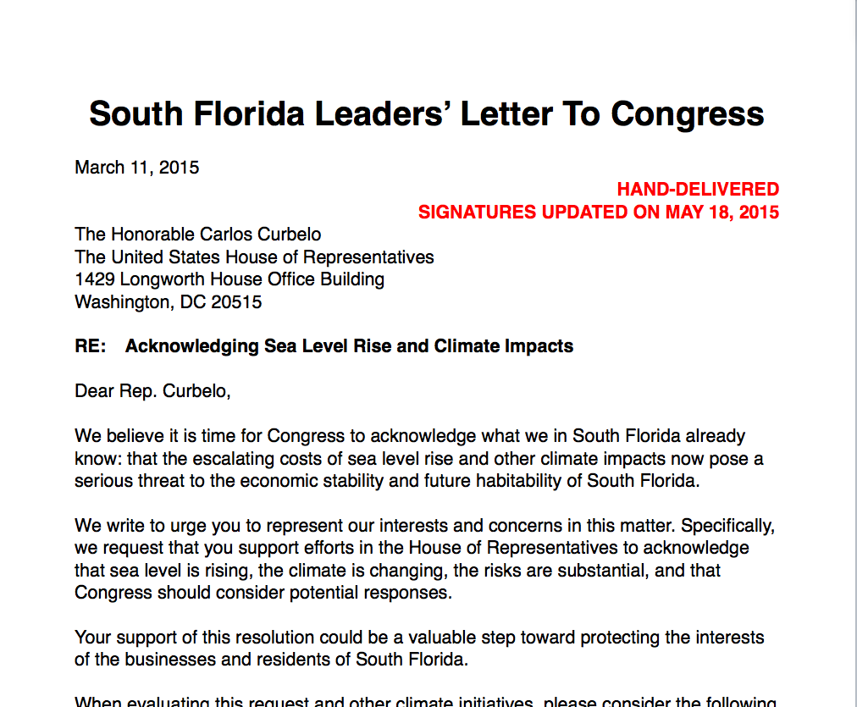
Successful Examples (con’t)
South Florida with Jay Butera
Built coalition
12 business leaders (incl. Chambers)
19 political leaders (incl. mayors)
12 university / research leaders
10 NGO / conservation leaders
Signed leaders letter and joined for meetings
“This was a game changer in our relationship with Congressman Curbelo’s office, and played a big role in gaining his signature on the Gibson Resolution.”
-Jay
Notes:
Jay

Slide 13
101
201
301

Slide 14
Agenda
1
Why is Local Support Important?
5
Preparing for Meetings
2
6
Climate Change: Local Impacts for National Issue
Lobbying for Success
3
7
Working with Chambers & Local Business Groups
Where to Begin?
4
8
Doing the Research
Success!
How do we use it?

Slide 15
Why Do We Want Support From Local Officials?
LTE Opportunities
It all begins with grassroots
Congress responds to constituents’ will
Political will is expressed through local officials
City councils, mayors, and chambers are close to their communities
Resolutions are endorsements on steroids
The more Congress hears from local officials the more they’ll pay attention
Helps shift the undecided and motivate the favorable
Notes:
WHY DO WE WANT SUPPORT FROM LOCAL LEGISLATIVE BODIES?
The effort to enact federal CFD legislation begins at the grassroots level.
Congress responds to and prioritizes the will of their constituents.
One way we can express our will is through our local municipal governing bodies.
City councils, boards of supervisors, city and county commissions, are close to their communities every day, are attentive to local voices, and can send strong messages on behalf of their entire communities.
Resolutions are endorsements on steroids. When a city passes one, they are sending a message to Congress on behalf of potentially thousands of people.
The more that Congress and the Senate hear from local municipalities, the more attention will be paid to passing legislation implementing CFD.

Slide 16
Where to Begin?
LTE Opportunities
Create a team
Meet and develop a plan
Identify your target
Develop a timeline
Identify a potential champion
Map your personal connections
Find allies for your coalition
Which outside groups will support?
Develop a media list
Notes:
WHERE TO BEGIN
Create a team of people in your chapter who want to work on passing a resolution.
Meet and develop a plan with commitments and assignments for team members.
Identify your target - Do you want it to be your City Council or the Board of
Supervisors? Is there an energy commission or similar agency which should be
lobbied first or is your strategy to go straight to the council?
Develop a timeline. By what date do you want to pass a resolution? What can you
realistically do and by when?
Identify a potential champion on the council who can help you advance your cause.
Does anyone in your chapter know someone on the Council, or within City Hall, or have a relationship with someone through a service club, religious organization or nonprofit?
Find allies for your coalition: Who are the people outside of CCL who would be good to take with you to your meetings with council members? Your pastor, a scientist, economist, college professor, and people who are influential to each council member are good possibilities.
Consider which outside groups might support you in your efforts. People in environmental organizations, for example, might attend the City Council hearings when you speak or make a presentation, might make phone calls on behalf of the resolution’s passage, or may know someone within the City Council.
Develop a media list with contact information. Create a press release to send out after you pass your resolution.

Slide 17
Lobbying For Success
LTE Opportunities
Schedule 1-on-1’s first or consider presenting at neutral location
Keep delegation small & identify point person
Include someone with your council’s ear
Be prepared to describe and make the case for Carbon Fee & Dividend
Stay focused, be persuasive and concise
Practice, practice, practice
Avoid hyperbole, be yourself
Share your story
Appreciate each council member’s values
Be respectful and a good listener
Notes:
LOBBYING FOR SUCCESS
· Schedule meetings and meet with each council member, one at a time. Another possibility is to do a presentation on CFD at a neutral location and invite all of your council members to attend. Or do both!
· Keep your delegation small and pick a primary spokesperson for your meetings.
· When possible, include in your meeting a supporter who has access to the councilman. Consider resources you may have in your chapter or from a nearby college, faith or environmental organization.
· Come prepared with data and arguments on behalf of CFD. Stay focused on key, persuasive talking points.
· Do practice runs to prepare for objections and arguments. If you have a team working on the resolution, meet together and strategize in advance of your meetings.
· Be prepared with a concise agenda. How much time will you be allowed? Organization is the key to a productive meeting, especially since this may be the only chance you’ll have for face time.
· You can make emotional appeals but avoid hyperbole. Keep your meeting business-like and dress for success.
· Do you have a story to tell about how climate change has affected you or someone close to you? Your stories make the issue real and relatable. This can be tied to your local impacts which affect the health and economics of the community.
· Appreciate each council member’s values, for example their concerns about open space, clean water, or economic stability, from the research you’ve done. Thank the council member for pro-environmental votes taken in the past.
· Be respectful and politely persistent; don’t interrupt and NEVER threaten, blame or raise political affiliations. Handle the conversation in the CCL way: With respect, gratitude and appreciation.
· Be a good listener: Opposing council members can provide valuable insights. It’s up to you to find common ground.
· Be the “go to” person for information on climate-related issues for your council members. Let them know that you’re available to answer questions after your meeting and to continue the relationship you’ve begun building in your meeting. If you’re interested in doing a presentation before the council, talk with individual council members about it. Try to get a feel for how each council member will vote. If you find a particularly sympathetic council member, would he consider being your champion to help you through the process?

Slide 18
Drafting the Resolution
LTE Opportunities
Work with your legislative champion
Share examples
Aim for succinctness, clarity & simplicity
Make it suitable for your community
Describe severity of the problem
Highlight Carbon Fee & Dividend’s effectiveness, fairness, and benefits
General scientific data can be included, put details in appendix
Notes:
Ask your legislative champion for information on what works for your city. Show him several hard copy examples of resolutions from the CCL public website. Oftentimes, Staff will select one to use or will write their own.
Aim for succinctness, clarity and simplicity. Review some of the resolutions on the municipal resolutions page for examples.
Develop a resolution that is suitable for your public body.
Include language about the severity of the problem and the urgent need for action.
Include a description of CFD, its effectiveness, fairness and economic benefits. For information, go to the main CCL website home page under “Our Climate Solution.”
You can include scientific data in general terms. Detailed information and local impacts can be included in an appendix. For an example of this, see the Modesto, California, resolution.

